Slide 1
applying for state jobs
What do I need to know
Notes:
My name is Lisa Hale and I work for the State of Delaware in the Talent & Acquisition section.
Today we are going to go over the application system to help you get a better understanding of what applicants should be aware of when applying. This will include some tips to help them. Does that sound ok?
Well let’s get started!

Slide 2
Did you sign up for email alerts?
Notes:
First thing, did you know that instead of checking the website everyday you can set up email alerts that will notify you when a position of interest opens on our website?
For 180 days you will be notified when the chosen positions open
Set up a reminder to be notified again at day 175
Can cancel anytime using initial email confirmation
By click on the email alerts option, you will be directed to what we call an “occupational grouping” page.

Slide 3
Occupational Grouping
Notes:
What is occupational grouping?
Well it is grouping a series of classifications (positions) within the same occupational field together. The work they perform is similar enough in nature to be joined within the same group.
For example:
Accounting and Fiscal
Law Enforcement and Public Safety
Administrative and Support Services
If we were to click on one of these occupational groups, it would filter the over 1500 job titles the state has and only show you the ones that fall into these areas.
So let’s look at the Administrative and Support Services

Slide 4
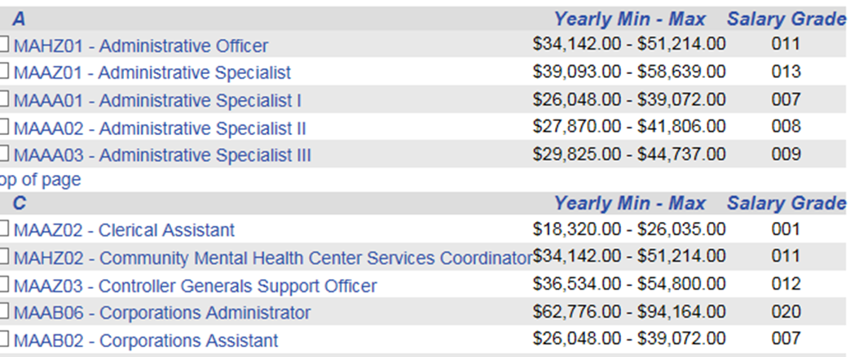
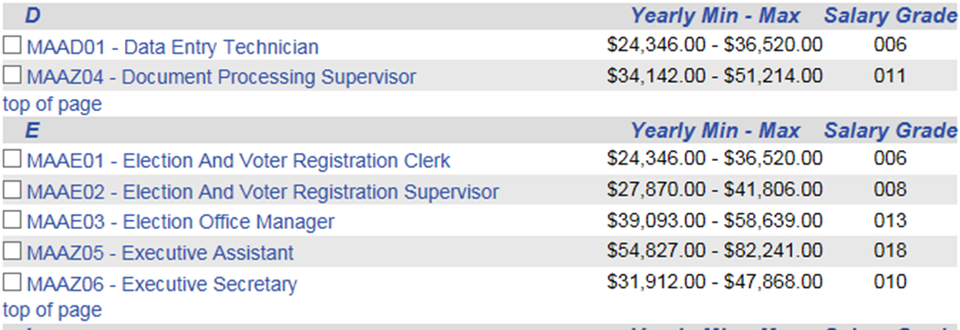
Occupational Grouping
Notes:
As you can see, this group includes the Administrative Specialist, but it also includes the Corporations Assistant, Executive Secretary, and many more positions.
From this screen, you can select the title of the position to find out more, or if you know you are interested in this position, you can click on the box to select to be notified. Once you have selected all the classes, you are interested in, click on “add all checked classes to my job search” located at the top of the page. Once you do this, you will be directed to another page.

Slide 5
Occupational Grouping
Notes:
This page will show you the classes you are requesting to be notified about. From here you can click “finish” if you are done or you can continue searching other classes repeating the steps I mentioned earlier.

Slide 6
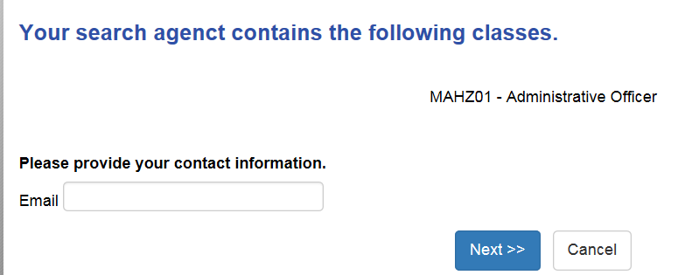
Occupational Grouping
Notes:
Once you click finish, enter your email address and you are done.
Any questions about email alerts?

Slide 7
Posting
Open/close dates
Type of recruitment
Location
Summary of the position
Job Requirements
Additional information
Notes:
Now let’s go over some information on the posting. It is important to look at the posting because it gives you some great information.

Slide 8
Open/Close
Notes:
Ever look at the open and close dates? How about the time at the end of the recruitment?
Most posting are only open for 7 days and close at 11:59:00 pm.
What does that mean to a candidate?
They are working on limited time once the recruitment opens to type up and submit their application
Remember how I showed you the email alerts and I said you can click on the title to see more about the job? Well when you “look more at the job” you can see what the job requirements are.

Slide 9
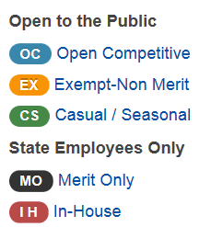
Type of recruitment
Notes:
I mentioned type of recruitment because certain recruitments are restricted to state employees only. Additionally, some positions might not offer benefits, or could be reduce hours of 29.75 or full time hours of 37.5 but not benefit eligible.

Slide 10
Location
Notes:
Location: important to know because if you work in new castle and this position is in Sussex-are you willing to travel that far?
Job requirements: including selectives
Additional information: conditions of hire such as a driver’s license, shots, certification.

Slide 11
Summary
The incumbent in this position is responsible for administering a statewide program resulting from the Food Safety Modernization Act. The incumbent is responsible for planning, coordinating and implementing a produce safety program to include outreach, education, technical assistance, training, sampling and enforcement activities. The incumbent administers program related grants including reporting, budgeting and monitoring. Other duties include: Providing technical guidance to a wide variety of fruit and vegetable producers and serving as point of contact for farmers, trade associations, school districts, farmers markets, state agencies and the public.
Notes:
Summary statement is going to tell you more about the position. Some might be generic, while others could be more specific like the one shown here.
Job requirements: including selectives
Additional information: conditions of hire such as a driver’s license, shots, certification.

Slide 12
Additional information
As a condition of hire, applicants must successfully complete all required training to become commissioned as an Officer of the Department of Health and Human Services Under Section 702(a) of the Food and Drug and Cosmetic Act, as amended, by the end of the one year probationary period.
As a condition of hire a satisfactory background investigation is required by the National Agency Check and Inquires (NACI).
Notes:
Additional information: conditions of hire such as a driver’s license, shots, certification.

Slide 13
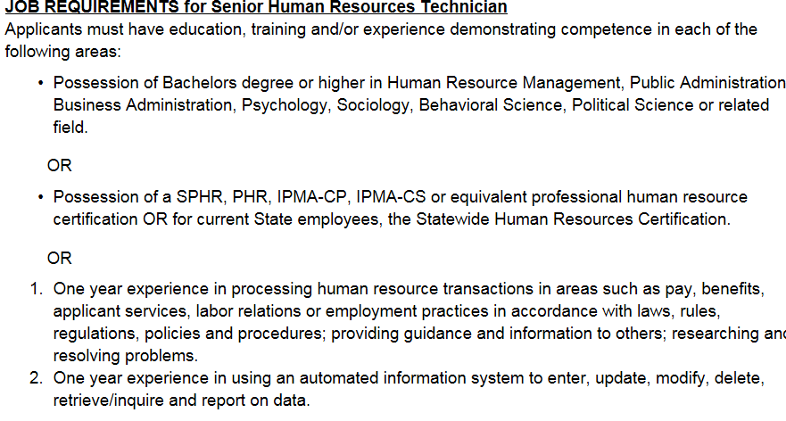
Job Requirements
Notes:
So now let’s look at these job requirements.
To help applicants prepare to answer the job requirements, here are a few tips:
Copy the job requirements from the class spec page, posting or job titles section onto a word document. Save it as the title of that position. If the position is not open yet, the only way you can get those job requirements is to copy it from the email alerts class spec page. This actually gives you a little more time to answer the questions and where the email alert option comes in handy.
Look at the job requirements. Looking at this one for the SR HR tech, the applicant has three ways to potentially qualify.
Bachelors degree
Certification
OR
Experience
The degree and certification requirements are pretty much straight forward, so let’s look at the experience a little deeper.

Slide 14
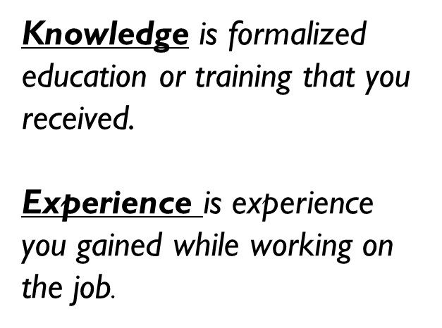
Knowledge Versus Experience
Notes:
Read the difference between the two.
If a job requirement asks for experience and you only have knowledge, that would not qualify. If it asks for Knowledge and you have experience, then that WOULD qualify.

Slide 15
Such AS VS Which Includes
One year experience in processing human resource transactions in areas such as pay, benefits, applicant services, labor relations or employment practices in accordance with laws, rules, regulations, policies and procedures; providing guidance and information to others; researching and resolving problems.
One year experience in processing financial transactions in areas such as accounting, auditing, payroll, or taxes.
One year experience in creating financial reports which includes combining and presenting financial data from multiple sources in an organized format.
Notes:
Explain the difference between such as and which includes
Such as are examples:
Which includes means you need to

Slide 16
Narrative Responses
To support your response, please provide a detailed description of your work experience to include employer, dates of employment, job title and duties. For education and training to support knowledge requirements, please provide educational providers, training course titles and summary of course content.
Notes:
Have you every seen this statement before on our applications?
When applicants respond to the job requirements, it is important that they provided a detailed description of their knowledge or experience as it relates to the requirement. This is important as the applicant is the best person to tell us how they meet the requirement. Who knows the job the applicant has been doing better than themselves?
Answering the questions give the applicant the opportunity to show the hiring manager what they have experience doing.
The applicant is the official request for an interview.

Slide 17
Narrative Responses should not…
State “See Resume”
State “See above”
Be a repetition of response to previous questions
Be the same as your resume
Notes:
Read each response as they bounce, provide more detail to 3rd and 4th responses
Each question is different for a reason
Leaves room for judgement.

Slide 18
Employment History
How far back do I go?
As far back as you need to so that your knowledge and/or experience can be verified
Be sure to include the correct employment dates
Part time credit is given for part time work
Notes:
If you refer to a certain employment experience in your narrative response, it is important to make sure that it is included in your employment history. this way your application can be given the most credit possible.

Slide 19
Other questions
Ranking questions/Exams
Selectives
Preferences
Notes:
Some other questions you might see on the application will include ranking questions, exam/agency questions, selective and preferences.

Slide 20
Other questions
Training and Experience
Less than 30
More than 30
Notes:
You might see some other questions on the application. This is typically associated with positions that historically receive more than 30 qualified applicants. If a position receives more than 30 qualified applicants, those applicants are ranked based on training and experience. The more experience you have the higher you rank.
This is where the details in your response come into play. Providing examples of your experience. Let’s look at an example of a JR vs a ranking question.

Slide 21
Job Requirement
Do you have 6 months experience in coordinating office activities such as planning/coordinating meetings or conferences; tracking workflow and follow up; composing meeting notes; directing clients/customers; explaining services to the public and customers/clients; establishing or maintaining filing/record systems?
Yes
No
Notes:
This question ends in “yes” or “no”

Slide 22
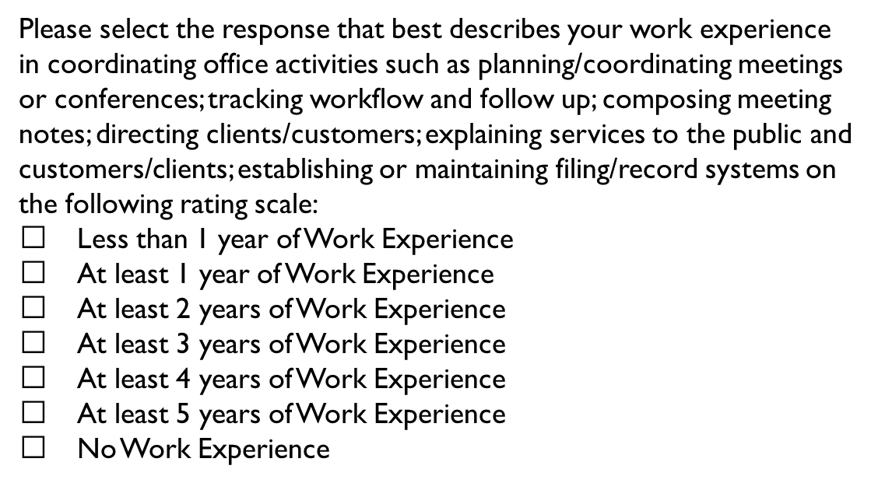
Ranking
Notes:
This one asks for years of experience. Again, the more years experience you have performing the work, the higher you rank. I mention the difference because although they look similar the ranking questions will not appear on the class spec, so you won’t know they are on the application, until they go to apply. Unless you have applied the position before.
The questions are similar, I realize that and we are working on making it less repetitive. So when applicants respond to these questions, this is their opportunity to provide more details and examples.
As an example, instead of saying, yes I have 3 years of experience in (repeat job requirement) {period}, you could say, yes I have three years experience in repeat job requirement because as an administrative specialist while working for HRM, I was responsible for coordinating our monthly meetings by reserving a conference room and sending out the meeting invite. I would make sure that if there were any handouts needed, I printed them and had them ready for distribution. Also while working as an AS, I answered the phone and addressed questions the public would have about a particular recruitment or their application.

Slide 23
Selective
Additional job requirements reflected on a job posting to screen applicants in addition to the Job Requirements for the classification. Applicants who do not possess the “Selective Requirement” along with the job requirements will not qualify.
Notes:
Selectives are just like job requirements; you must meet the selective in addition to the job requirements in order to move forward in the process.

Slide 24
Preference
A Preferential Qualification is used on a job posting indicating the desired education/training and/or experience. Applicants who meet the job requirements but not the preferred qualification still qualify.
A Preference is used on a job posting indicating the desired education/training and/or experience. Applicants who meet the job requirements but not the preferred qualification still qualify.

Slide 25
I am done with my application, now what?
A Preferential Qualification is used on a job posting indicating the desired education/training and/or experience. Applicants who meet the job requirements but not the preferred qualification still qualify.
Review it for accuracy
Spell check
Submit it
Notes:
Once you submit the application, an auto generated email will be sent to you to let you know that your application has been received by the Department of Human Resources.

Slide 26
When should I expect to hear something?
A Preferential Qualification is used on a job posting indicating the desired education/training and/or experience. Applicants who meet the job requirements but not the preferred qualification still qualify.
7-10 days
Notes:
On average it is taking between 7-10 days for the agency to evaluate all applications and give a response as to whether you have been found qualified or not.
If you have not heard back from the agency, check your spam mail or you can call the agency number listed on the posting to inquire on the status.
Remember, even though an applicant has been found qualified, it is does not mean that they will automatically receive a interview. That is up to the hiring manager-which again is why your application is your official request for an interview.

Slide 27
What if I forgot my user id or password
A Preferential Qualification is used on a job posting indicating the desired education/training and/or experience. Applicants who meet the job requirements but not the preferred qualification still qualify.
302-739-5458
Notes:
If you forgot your user id or password, no worries. Contact our office and we can walk you through resetting your password.
Whatever you do, do not create another account.

Slide 28
Additional resources (Statejobs.Delaware.gov)
Job Seeker Resources
Degree Directory
Career Counseling
You Tube videos
Test Study Guides
Total Compensation Calculator
Non Merit Job opportunities
DTCC
Delaware State Police
Department of Education/School Districts

Slide 29
Questions ???

